Slide 1
HTML5 List and Tables
Prof Maheswari S,
VIT Chennai

Slide 2
List tags – OL & UL
Ordered List
<ol>
<li> One </li>
<li> Two </li>
</ol
Unordered List
<ul>
<li> One </li>
<li> Two </li>
</ul

Slide 3
OL - List Attributes
Attribute | Value | Description
reversed | reversed | Specifies that the list order should be reversed (9,8,7...)
start | number | Specifies the start value of an ordered list
type | 1 A a I i | Specifies the kind of marker to use in the list

Slide 4
Example – start attribute
<ol start="10"> <li>Coffee</li> <li>Tea</li> <li>Milk</li> </ol>

Slide 5
With CSS
<ol style="list-style-type:upper-roman"> <li>Coffee</li> <li>Tea</li> <li>Milk</li> </ol> <ol style="list-style-type:lower-roman"> <li>Coffee</li> <li>Tea</li> <li>Milk</li> </ol>

Slide 6
UL – List Attributes
Attribute | Value
compact | compact
type | disc square circle

Slide 7
Example
<ul type = “circle”> <li>Coffee</li> <li>Tea</li> <li>Milk</li> </ul> <ul type= “disc”> <li>Coffee</li> <li>Tea</li> <li>Milk</li> </ul>

Slide 8
Definition List
Definition List
Example:
<dl>
<dt>veg</dt>
<dd>good for health</dd>
</dl>
Where, dt is term
dd is data

Slide 9
Table Tags
<caption> - Table Caption
<table>
<thead> - Table head
<tbody> - Table body
<colgroup> - Column group
<th> - Table header
<td> - Table data
<tr> - Table row

Slide 10
Example
<table>
<thead>
<tr>
<th>Name</th>
<th>Instrument</th>
</tr>
</thead>
<tfoot>
<tr>
<th>Name</th>
<th>Instrument</th>
</tr>
</tfoot>
</table>

Slide 11
<tbody>
<tr>
<td>George Harrison</td>
<td>Lead Guitar</td>
</tr>
<tr>
<td>Ringo Starr</td>
<td>Drums</td>
</tr>
</tbody>

Slide 12
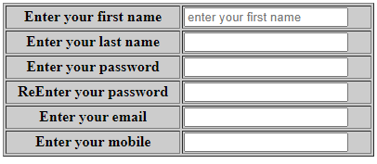
Table and its Attributes
<table border="1" align="center" width="400" bgcolor="#CCCCCC" >
<tr>
<th>Enter your first name</th>
<td> Magi</td>
</tr>
</table>
Example Program To Execute: Ex6_Table.html

Slide 13
Table Properties - With CSS
<html>
<head>
<title>Title of the document</title>
<style>
table, th, td { border: 1px solid #666; }
</style> </head>
<body>
<table style="width:80%;">
<tr> <th colspan="2">Month and Date</th> </tr>
<tr> <td>January</td> <td>10.01.2014</td> </tr>
<tr> <td>February</td> <td>10.01.2014</td> </tr> </table>
</body>
</html>

Slide 14
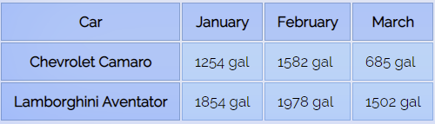
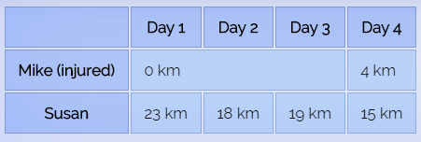
Screen Shots

Slide 15
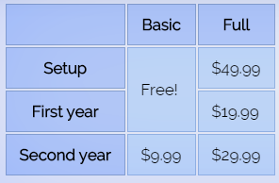
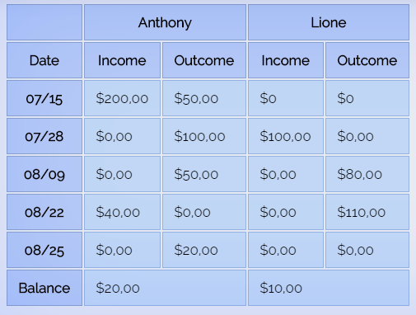

Slide 16
Examples
<table class="egt">
<colgroup>
<colgroup span="2" style="background: rgba(128, 255, 0, 0.3); border: 1px solid rgba(100, 200, 0, 0.3);">
</colgroup>
<colgroup span="2" style="background: rgba(255, 128, 0, 0.3); border: 1px solid rgba(200, 100, 0, 0.3);">
</colgroup>
<tr>
<th>
</th>
<th colspan="2">Mike</th>
<th colspan="2">Tara</th>
</tr>
<tr>
<th>
</th>
<th>First test</th>
<th>Second test</th>
<th>First test</th>
<th>Second test</th>
</tr>

Slide 17
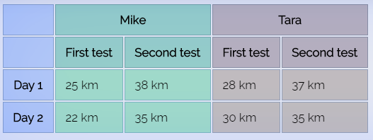
<tr>
<th>Day 1</th>
<td>25 km</td>
<td>38 km</td>
<td>28 km</td>
<td>37 km</td>
</tr>
<tr>
<th>Day 2</th>
<td>22 km</td>
<td>35 km</td>
<td>30 km</td>
<td>35 km</td>
</tr>
</table>

Slide 18
More Attributes
Cellpadding and cellspacing
<table cellpadding=“7" cellspacing=“7" border=“2">
Colspan and rowspan
<tr> <td>Row 2 - Col 1</td> <td colspan="2" rowspan="3">Row 2, 3 & 4 - Col 2 & 3</td> </tr>

Slide 19
THANK YOU

